Slide 1





Exercise 1
Big Data Processes

Slide 2





What We Will Cover Today:
Group Formation
Environment
Google Co-lab
Getting started on coding!
Notes:
Ask if anyone had any trouble installing Anaconda, if so they can ask for help
While on this slide mention Google Co-lab as a possibility they can use in their groups, but we will be using jupyter notebook.
I don’t know what the environment thing is
Still on this slide: Group formation: they can form their own groups or they can asked to be put in a random one, and we will create a group.

Slide 3
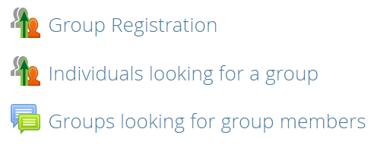
Group Formation
Group Registration for those who already have a group
Individuals looking for a group: you will join one large group and we will divide you into groups
Forum: for those who are looking for someone to join their group or looking for someone with the same interest
Deadline Thursday 23:59
Notes:
Ask if anyone had any trouble installing Anaconda, if so they can ask for help
While on this slide mention Google Co-lab as a possibility they can use in their groups, but we will be using jupyter notebook.
I don’t know what the environment thing is
Still on this slide: Group formation: they can form their own groups or they can asked to be put in a random one, and we will create a group.

Slide 4
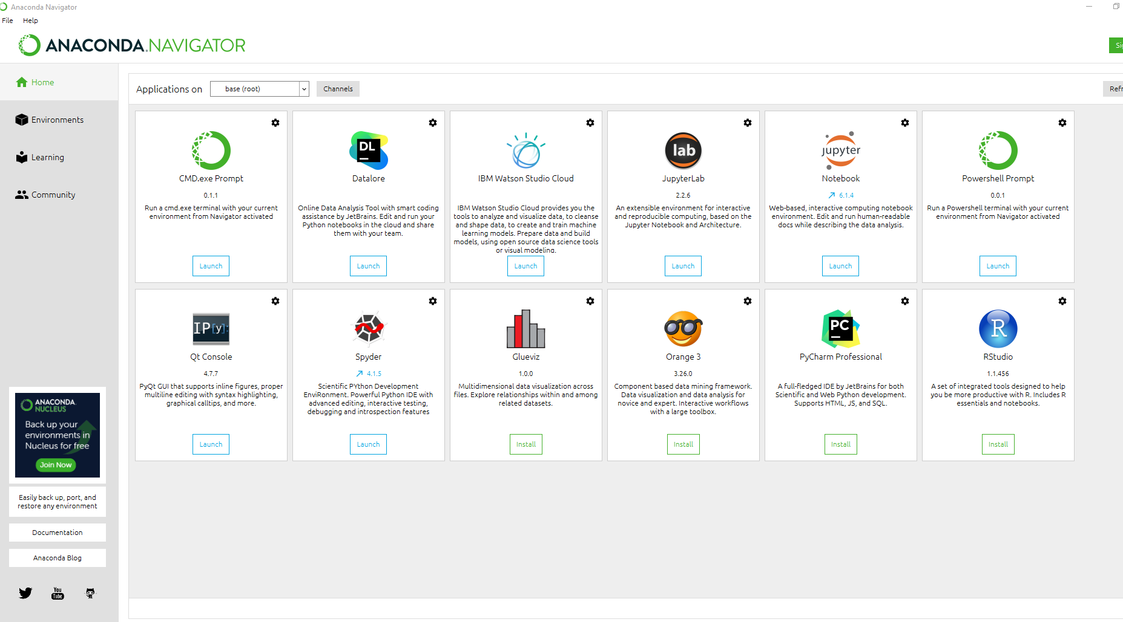
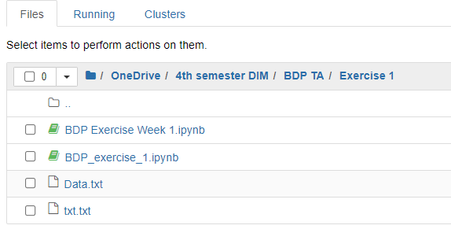
How to open a Jupyter Notebook
Save the ipynb and your data file(s) in the same folder
Open Anaconda Navigator on your computer
Click on Jupyter Notebook
Locate the file and click on it!

Slide 5
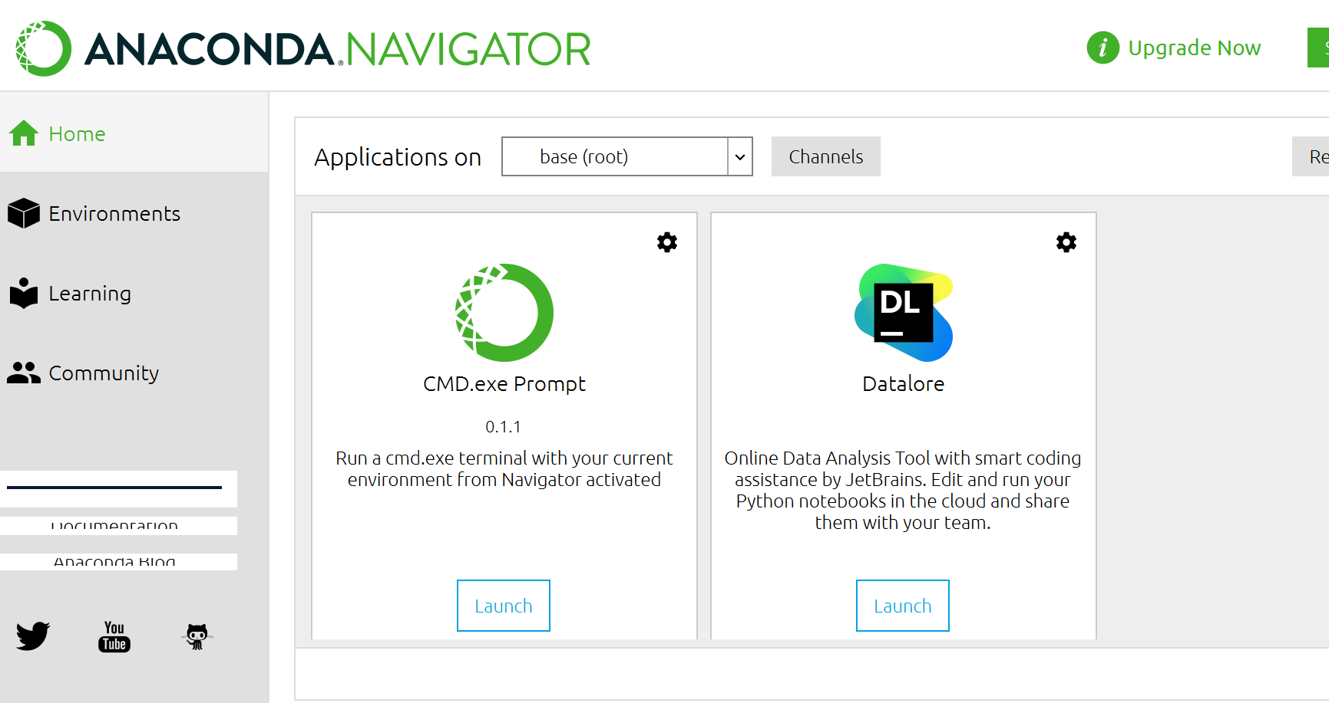
Environments
Virtual space for different versions of libraries and python.

Slide 6
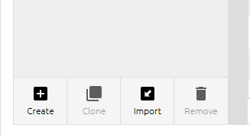
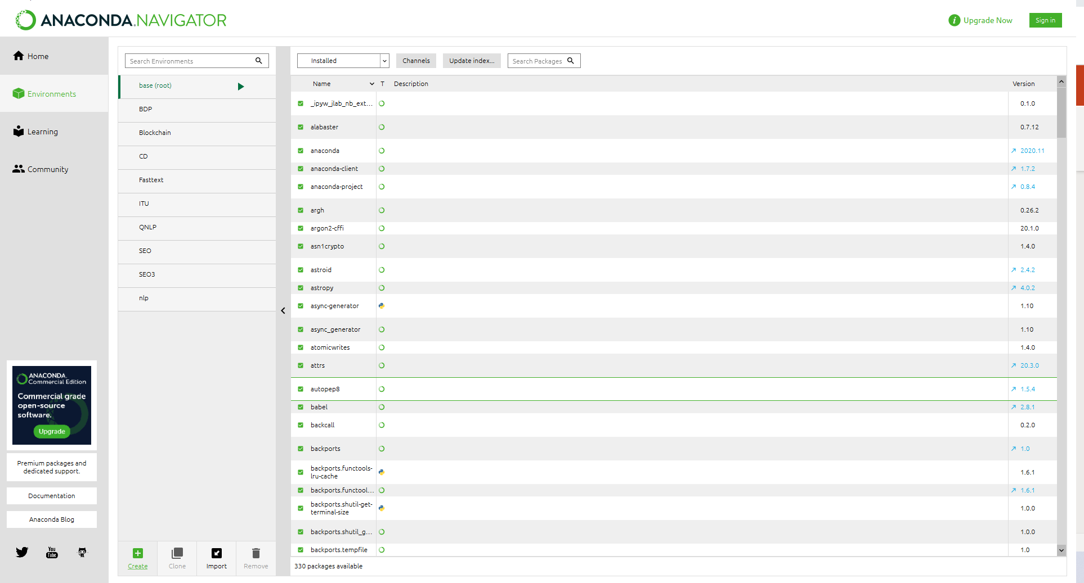
Creating newEnvironments
Virtual space for different versions of libraries and python.

Slide 7
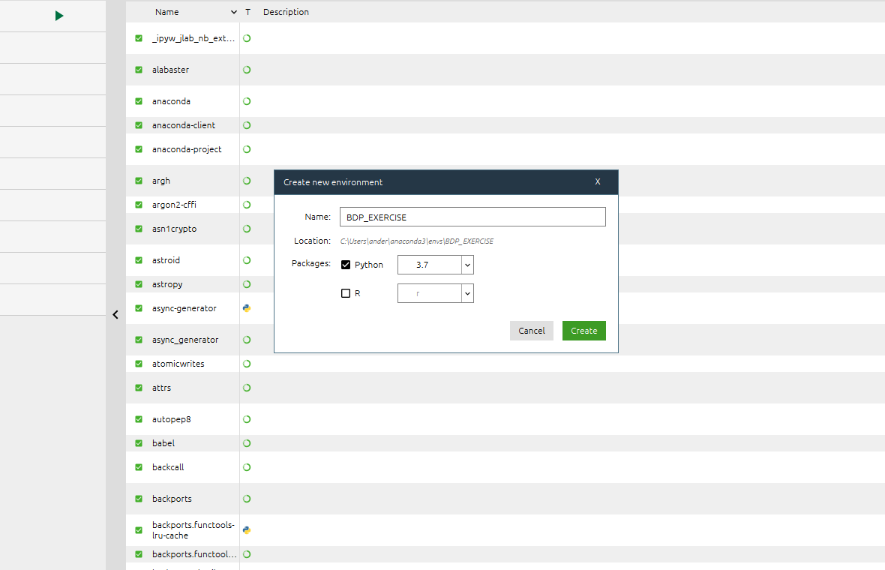
Environments
Virtual space for different versions of libraries and python.

Slide 8
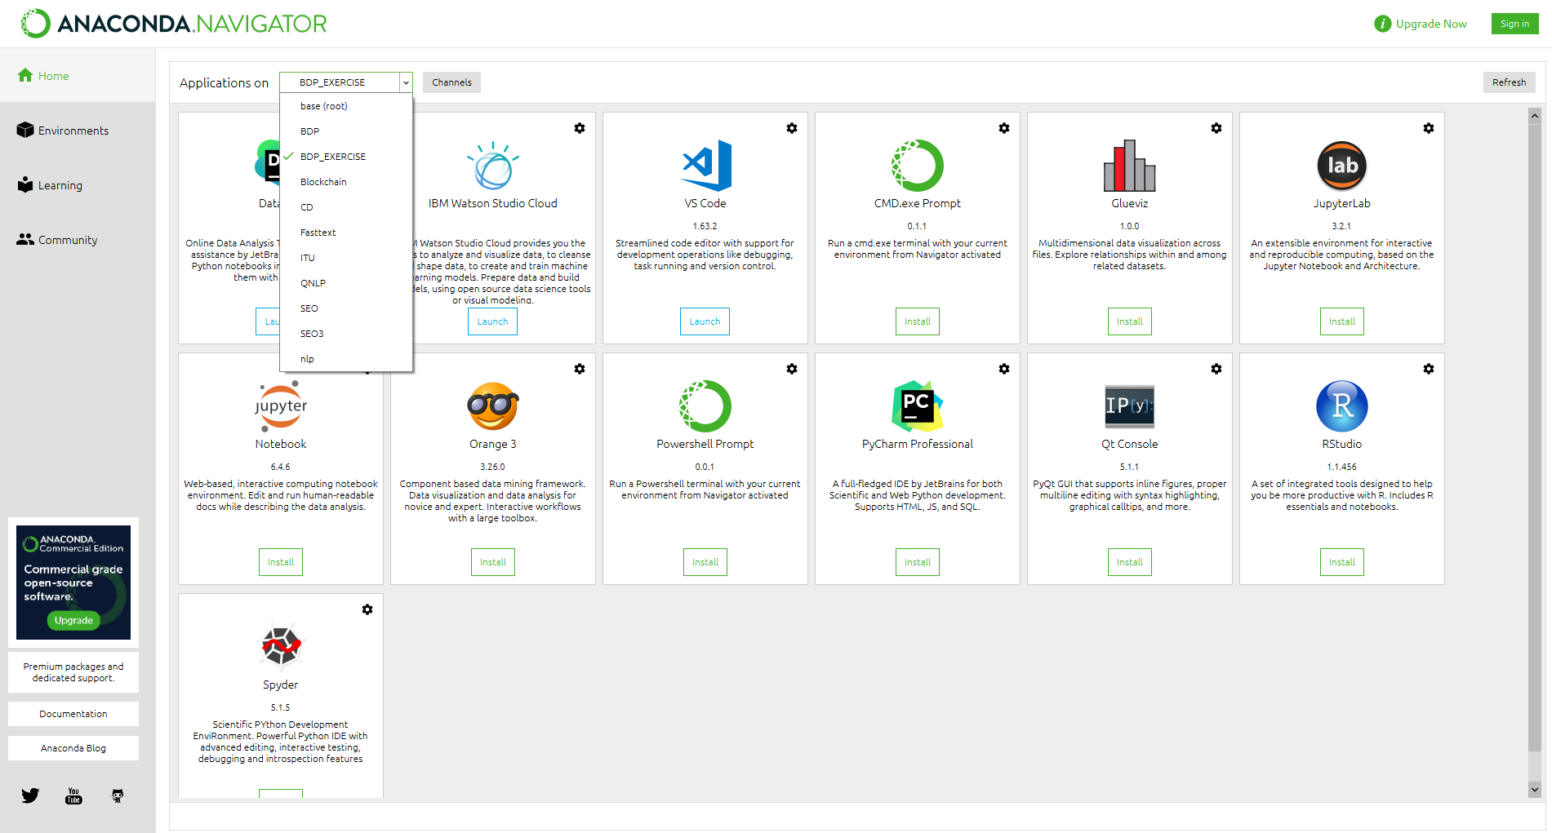
Navigating too Environments
Virtual space for different versions of libraries and python.

Slide 9
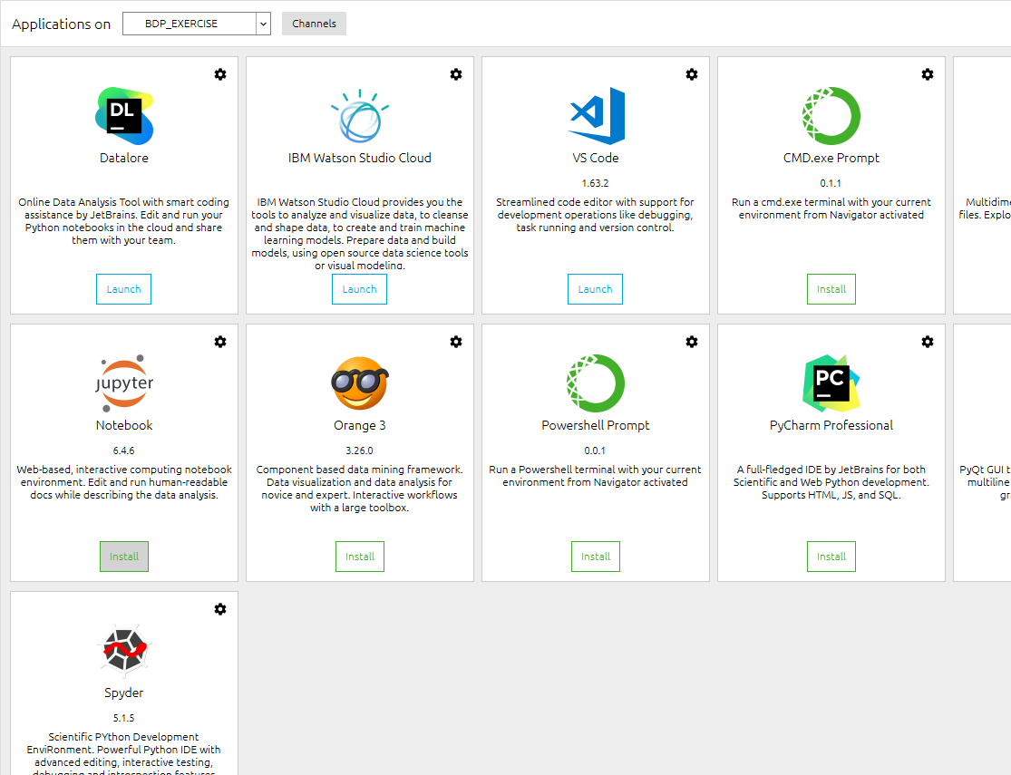
Entering notebook through Environments
Virtual space for different versions of libraries and python.

Slide 10
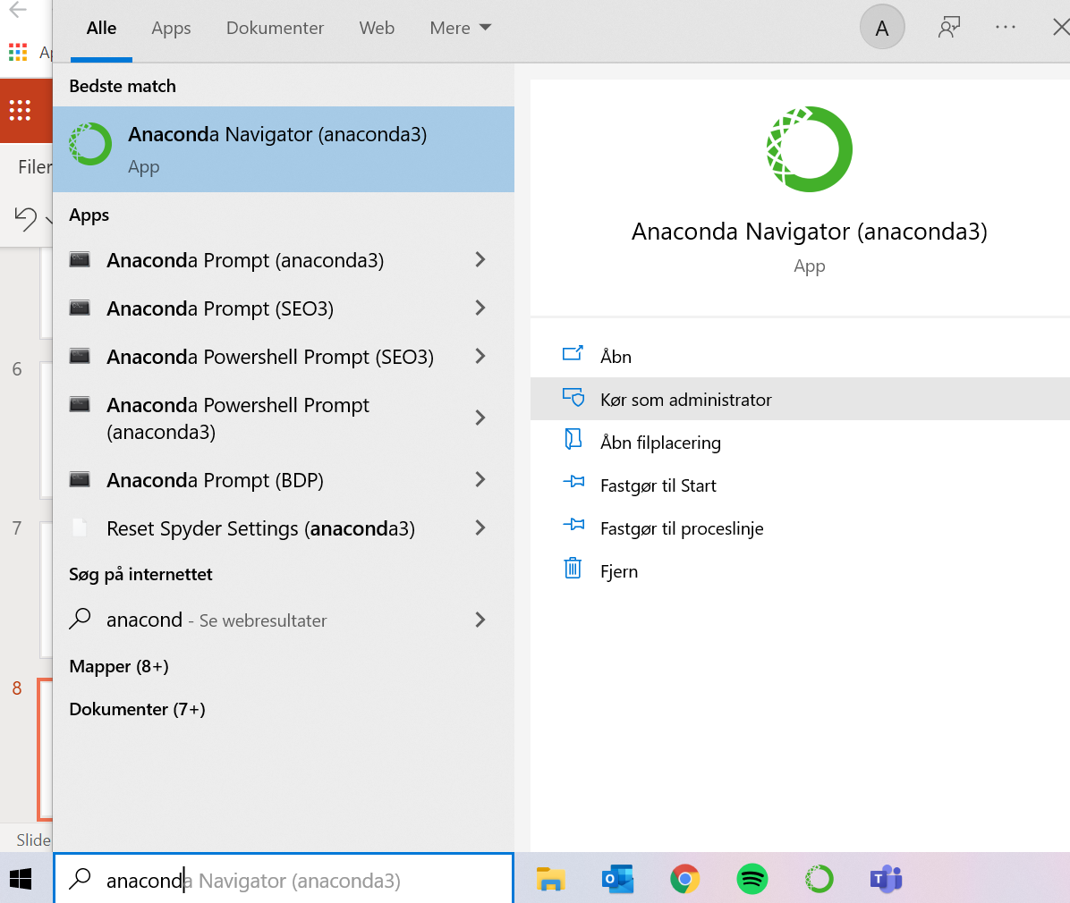
Environments
Virtual space for different versions of libraries and python.

Slide 11
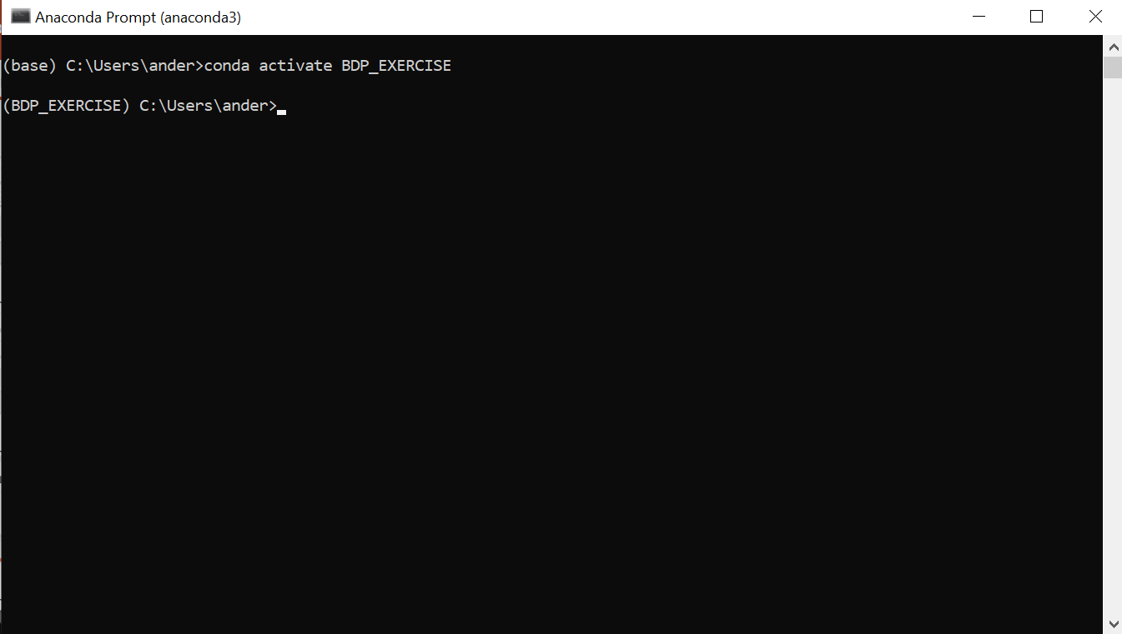
Installing libraries through Environments
Virtual space for different versions of libraries and python.
Conda activate BDP_EXERCISE

Slide 12
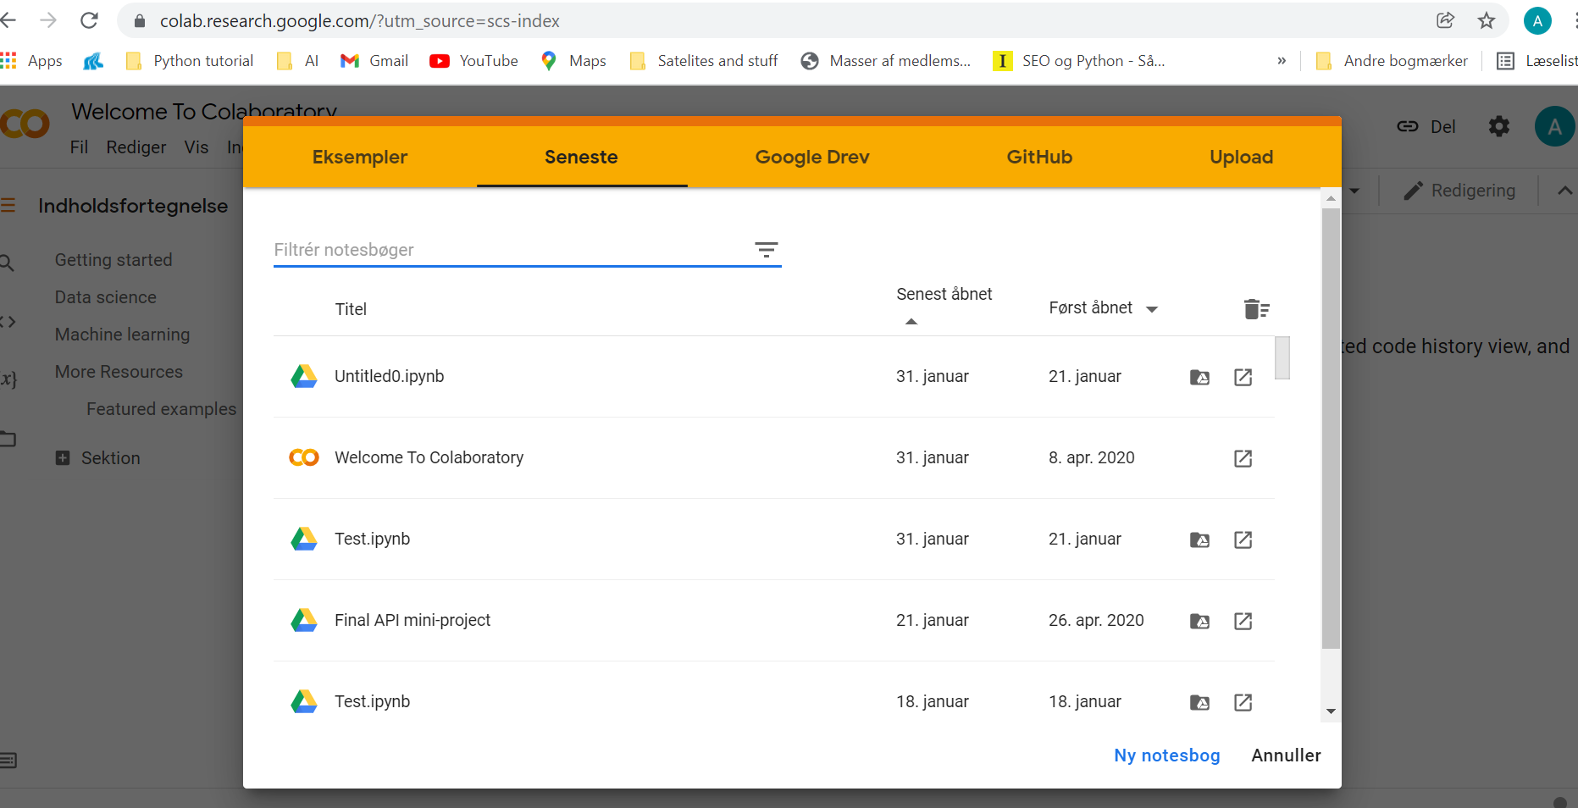
Google Colab
Sharing notebooks online

Slide 13
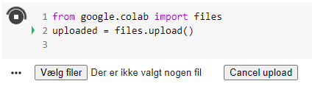
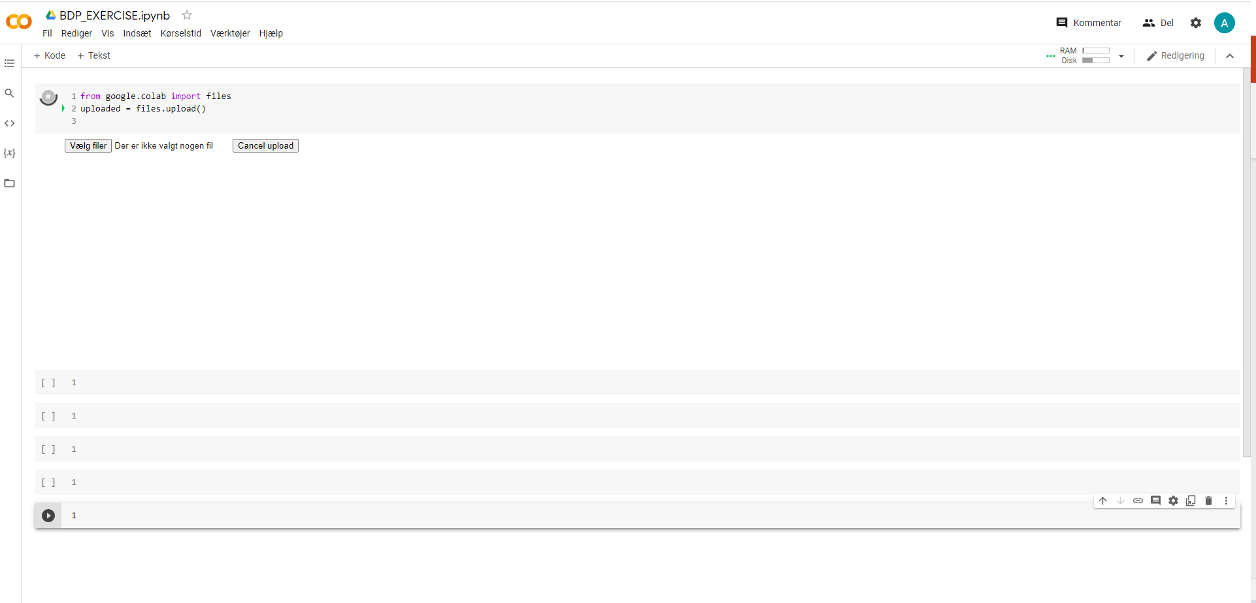
Google Colab
Sharing notebooks online

